Slide 1
Workshop 1

Slide 2
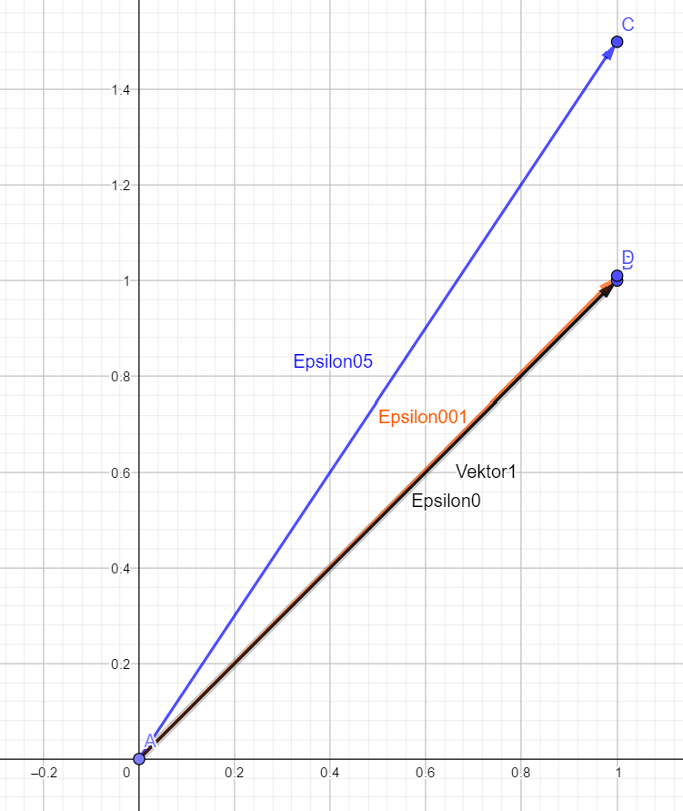



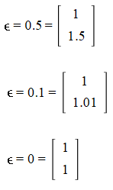

Linearly dependent
Linearly independent
Notes:
Since epsilon is a value for some amount of noise in an image. It is the reason as to why some values in the matrix is not linearly dependant. Because it is not possible to scale the first vector so that it gives us or however when it is linearly dependant, since we can scale the first vector with to get that. Therefore the closer then becomes almost linearly dependent

Slide 3






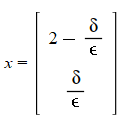
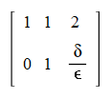


Slide 4
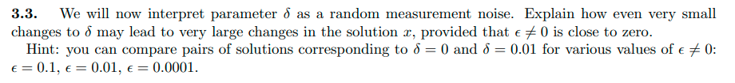

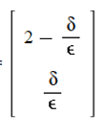



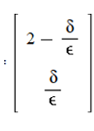



lim
lim

